Slide 1
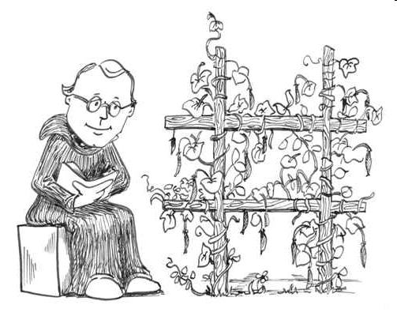
Chapter 9 – Fundamentals of Genetics
STEM Biology
Innovation Central High School
Ms. Robinson

Slide 2
What is Genetics?
A field in biology devoted to understanding how characteristics are passed from parent to offspring
Founded by Gregor Mendel
http://www.youtube.com/watch?v=B_PQ8qYtUL0

Slide 3
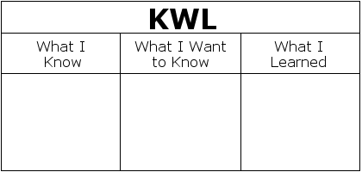
KWL Inheritance
  Remember Inheritance is receiving genetic qualities (traits) from parents.

Slide 4
The Big Picture Question
How does the genetics affect us individually?
How does genetics impact our so society and the environment?

Slide 5
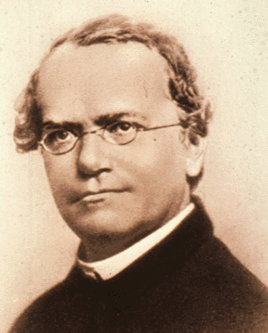
Who is Gregor Mendel?
Austrian monk
Experimented with pea plants.
Studied heredity – the transmission of characteristics from parents to offspring.
Mendel's work was not recognized until the turn of the 20th century
Video
  http://www.youtube.com/watch?v=aDpLDBaEBjk

Slide 6
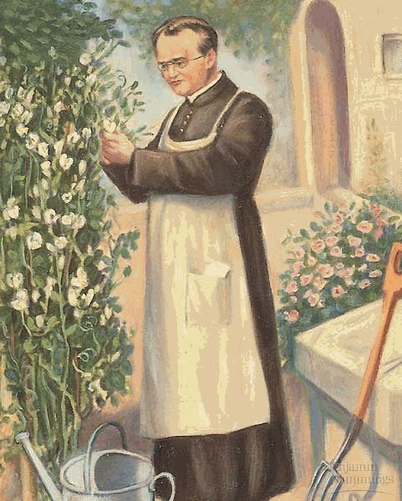
Mendel’s Garden Peas
Mendel observed traits – characteristics coded from genes.
He observed many traits
of pea plants:
  height
  flower position on stem
  pod appearance
  seed texture
  seed color
  flower color
WHY PEAS?
  easy to grow
  easy to pollinate (either self or cross)
  easy to study their TRAITS (characteristics)

Slide 7
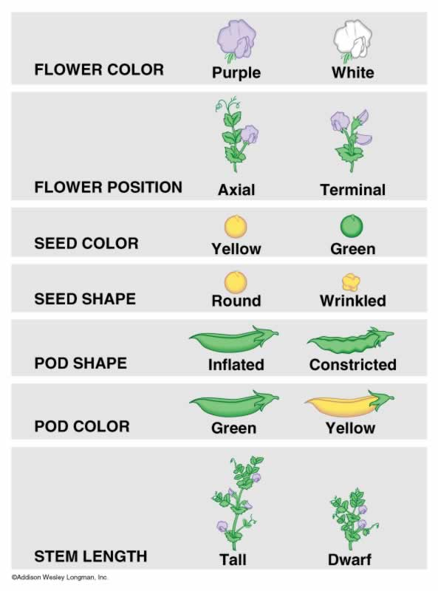

Slide 8
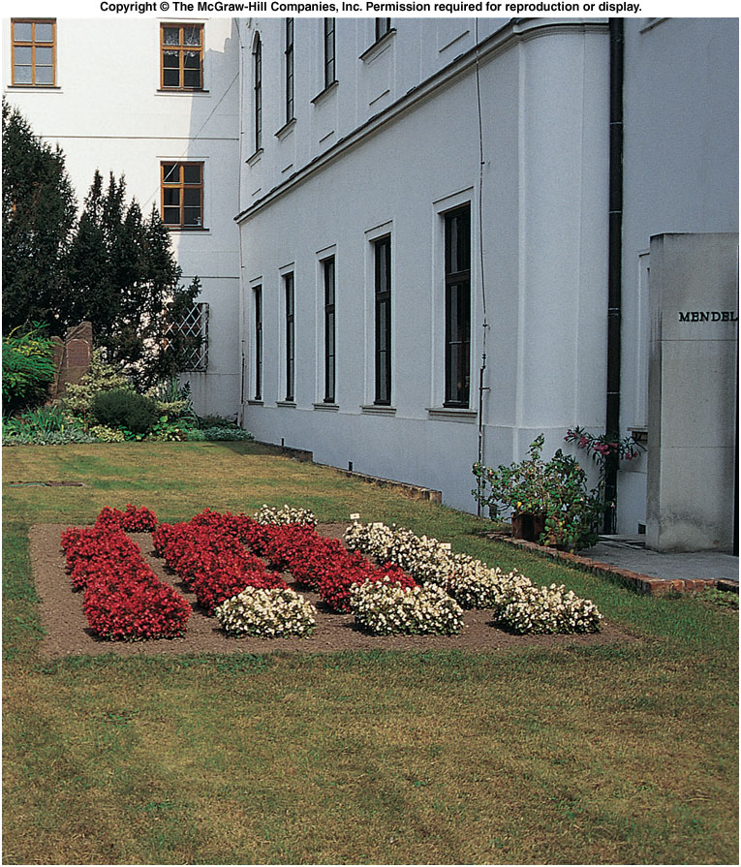
Site of Gregor Mendel’s experimental garden in the Czech Republic
Notes:
Fig. 5.co

Slide 9
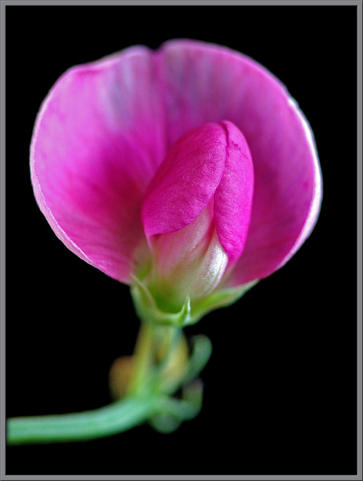
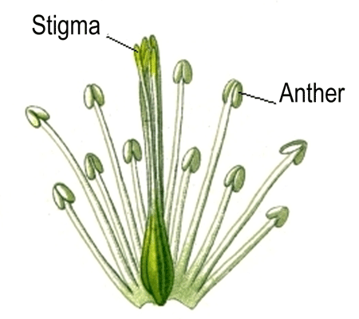
Mendel’s Methods
Mendel controlled how the pea plants pollinated so that he can track traits.
Pollination – pollen from male part of a flower, called the anthers are transferred to the female part of a flower, called the stigma.

Slide 10
Pollination
Self-pollination – pollen is transferred to the stigma of the same flower.
Cross-pollination – pollen from one flower is transferred to the stigma of a different flower.
Which pollination will produce genetically diverse offspring?

Slide 11
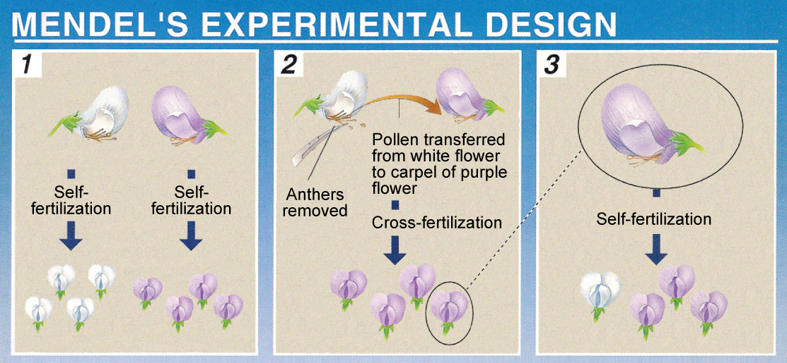
Self- pollination
Self- pollination
Cross- pollination
Self- pollination

Slide 12
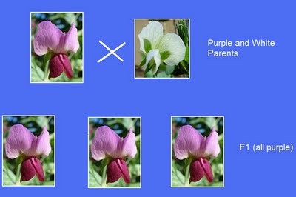
Mendel’s Experiments
Studied each characteristic
Grew plants that were pure for a trait → always produced offspring with that trait.
  Ex: Plants pure for the Tall trait self-pollinated and produced tall offspring.
Also cross- pollinated pure plants.

Slide 13
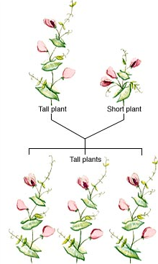
Mendel’s Results and Conclusions
Mendel crossed a pure tall plant with a pure short plant.
  Result: ALL offspring was tall.
What happened to the short trait?
Traits are carried on alleles – form of a gene.
  Ex: allele for Tall, allele for short (same trait but different variation).
  Organisms have two alleles for one trait.

Slide 14
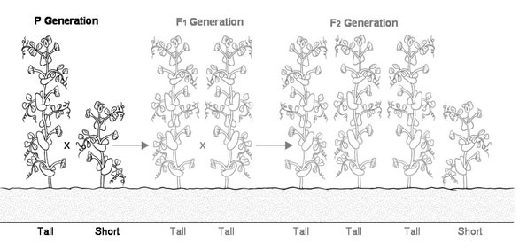
Terms to Know
P1 – first, parental generation
F1 – offspring of P1 generation
F2 – offspring of F1 generation

Slide 15
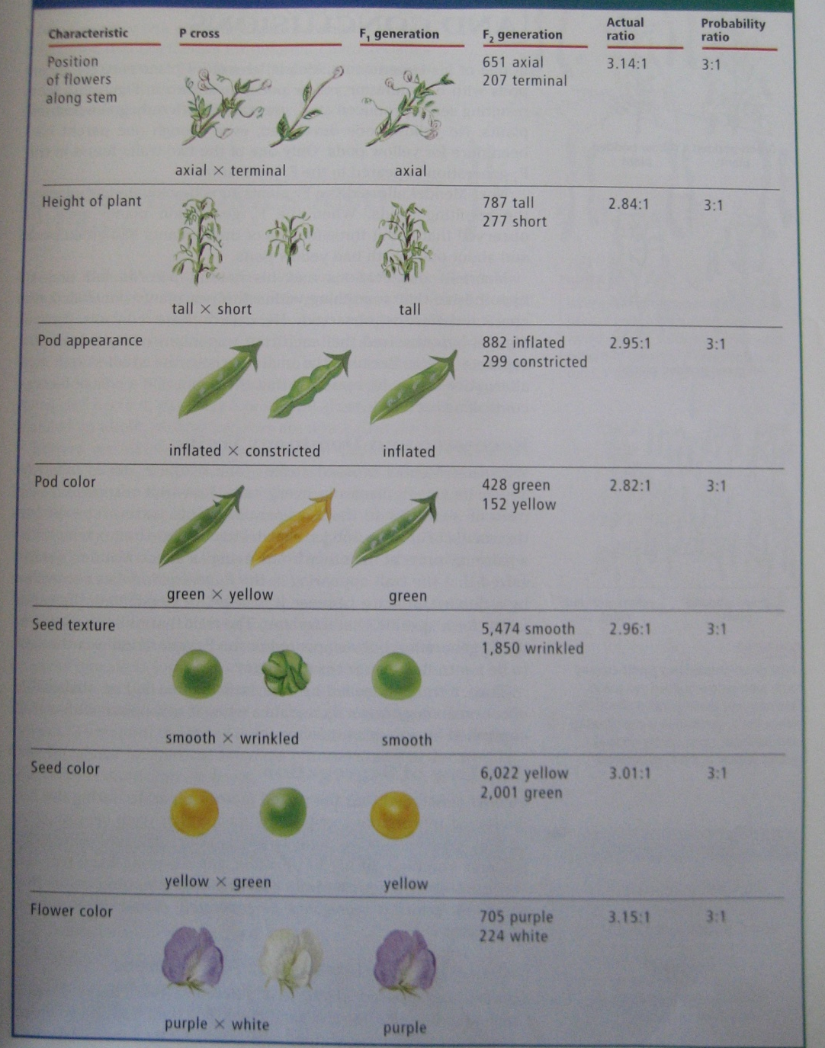
Mendel’s Crosses & Results

Slide 16
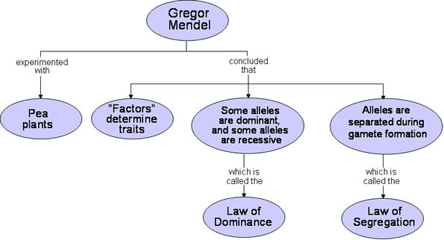
Mendel’s Three Laws
Mendel's Principal of Dominance
Mendel's Principle of Segregation
Mendel’s Principle of Independent Assortment

Slide 17
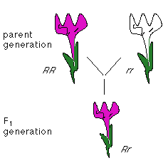
Law of Dominance
From Mendel’s work he concluded that one factor in a pair may prevent the other from having an effect.
Hypothesis: A trait appearing in the F1 generation was controlled by dominant factor meaning that the dominant factor masked the recessive factor.

Slide 18
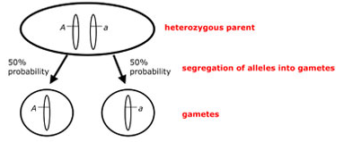
Law of Segregation
Alleles separate during the formation of gametes (Meiosis).
Only one allele of the parent is found in a gamete.
  Ex. If a plant is has alleles Tt for height they will produce gametes with either T or t in them. Only one will be fertilized.

Slide 19
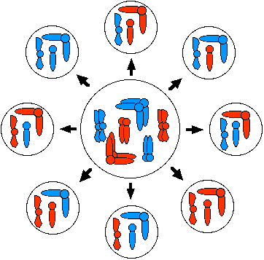
The Law of Independent Assortment
Alleles for different traits are distributed to gametes independently.
Factors for different characteristics are not connected.
An offspring won’t have
both alleles from its
mother or father.

Slide 20

Summary Video
http://www.youtube.com/watch?v=NWqgZUnJdAY
Time: 5:20 - 7:20
http://www.youtube.com/watch?v=ya7h-Y-9l8c
Time: 3:00 -6:50

Slide 21
References
Shuey, K. (n.d.). Chapter 9-Fundamentals of Genetics [PowerPoint]. Retrieved from http://kelly-a-shuey-portfolio.wikispaces.com/file/view/Chapter%209%20%E2%80%93%20Fundamentals%20of%20Genetics.ppt/140886069/Chapter%209%20%E2%80%93%20Fundamentals%20of%20Genetics.ppt.

