Slide 1
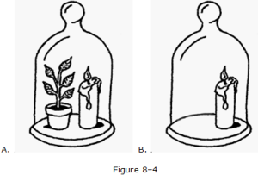
Warm-Up: Monday, January 13
In picture below, why might the candle in jar A burn longer than the candle in jar B?
Carbon dioxide produced by the plant allows the candle to burn longer.
Chlorophyll produced by the plant allows the candle to burn longer.
Glucose produced by the plant allows the candle to burn longer.
Oxygen produced by the plant allows the candle to burn longer.
A
B

Slide 2
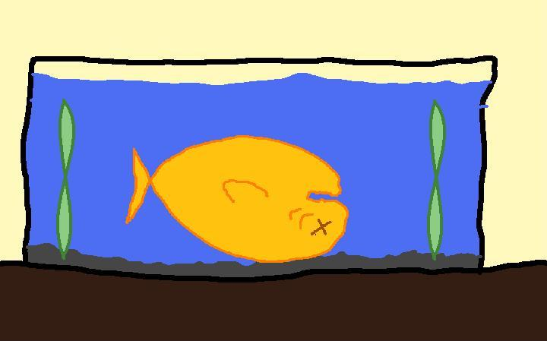
Warm-Up: Tuesday, January 14
You decide to buy a new fish for your freshwater aquarium. When you introduce the fish into its new tank, the fish swells up and dies. You later learn that it was a fish from the ocean.
Based on what you know of osmosis, the most likely explanation is that unfortunate fish went from a(n) _______________ solution into a(n) _______________ solution.
    isotonic, hypotonic
    isotonic, hypertonic
    hypotonic, hypertonic
    hypotonic, isotonic
*Explain the reason for
selecting your answer.

Slide 3
NEW WEEK SLIDES
January 21-January 24

Slide 4
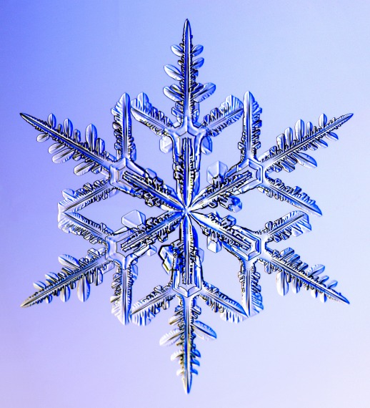
Tuesday, January 21, 2014
Today’s Agenda
New seats!
Warm-Up
5 Questions about Cell Reproduction
Pre-Test
Snow is Not White!
Snow is actually clear and colorless.
“The complex structure of snow crystals produces tiny surfaces that cause light to be reflected. The sunlight that is absorbed by the snow is absorbed uniformly over the wavelengths of visible light thus giving snow its white appearance.”
- National Snow and Ice Data Center
Fun Fact
Today’s Needs: Binder, Lined Paper, & Pencil

Slide 5
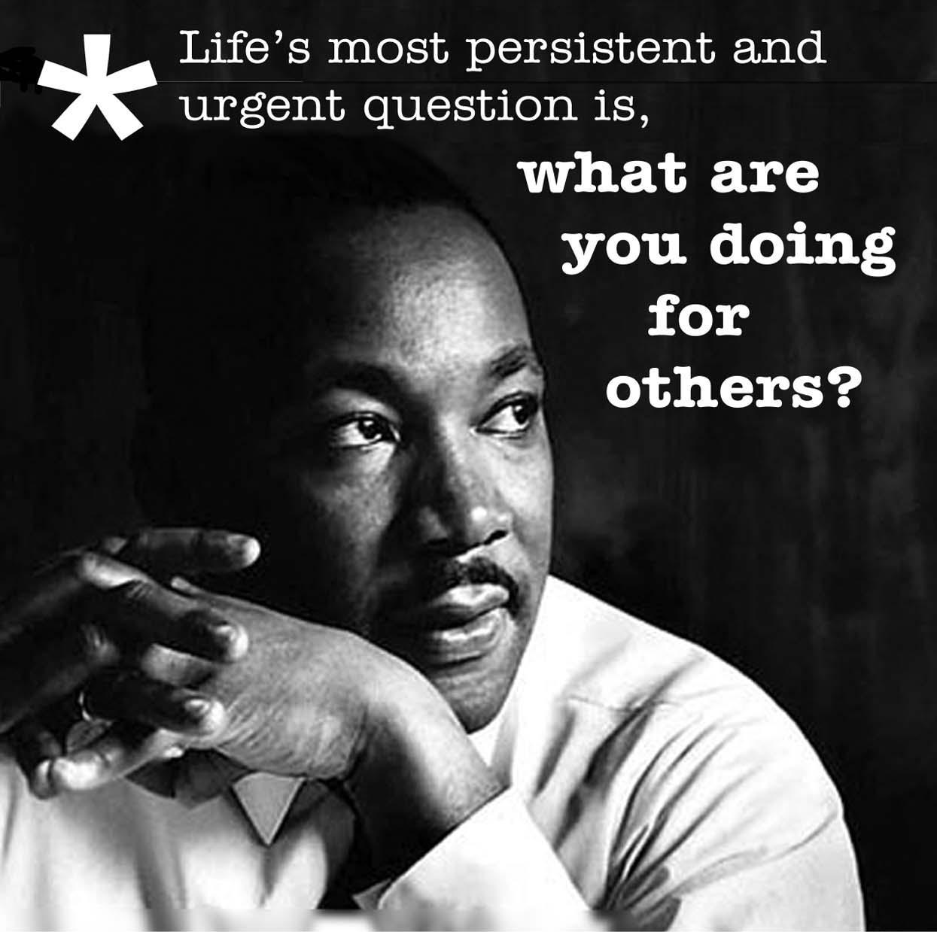
Warm-Up
In this speech, King shared his dream of a world where all people lived in peace and harmony.
Your Task:
Write about a dream you have for making the world a better place.
*3-5 complete sentences
Martin Luther King gave a famous speech entitled "I Have a Dream."

Slide 6
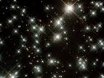
Wednesday, January 22, 2014
Fun Fact
Today’s Agenda
Warm-Up
Parent Letter
Organize Binder
Cell Reproduction
Despite how often stars are claimed to “twinkle” this is not true.
The twinkling effect is merely the light from the star passing through the Earth’s atmosphere, and it is merely deflecting the light before it reaches your eyes.
Today’s Needs: Binder/Folder & Pencil/Pen

Slide 7
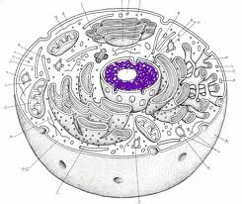
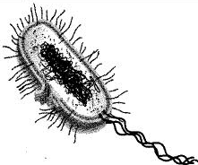
Warm-Up
Which of the diagram below is a prokaryotic cell and which is a eukaryotic cell?
How can you tell? Support your answer to Question 1.
What is labeled with the LETTER X in both of these pictures below?
X
X

Slide 8
NEW WEEK SLIDES
January 27-January 31

Slide 9
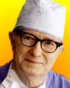
Wednesday, January 28, 2014
Fun Fact
Today’s Agenda
Warm-Up
Karyotype Lab Go Over
Review
Quiz
In 1964, the first animal to human heart transplant was made. Dr. James Hardy at the University of Mississippi transplanted the heart of a chimpanzee (named Bino) into the chest of Boyd Rush (age 68) in a last-ditch effort to save the man's life because no human was heart available. The newly-transplanted heart beat on its own; but it was too small to maintain independent circulation and Rush died after 90 minutes.
Today’s Needs: Binder/Folder & Pencil/Pen

Slide 10
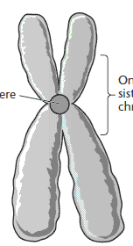
Warm-Up
Draw the following diagram and label the parts.
What is this diagram a picture of?
What is A?
What is B?
A
B

Slide 11
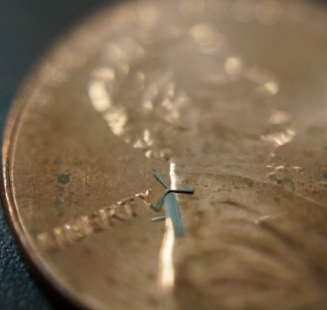
Thursday, January 30, 2014
Today’s Agenda
Pick up Ch. 8 packet (in back near highlighters)
Warm-Up
Critical Reading
Fun Fact
On January, 15, 2014, research associate and electrical engineering professor designed a micro-windmill that generates wind energy and may become an innovative solution to cell phone batteries constantly in need of recharging and home energy generation where large windmills are not preferred.
Today’s Needs: Binder/Folder & Pencil/Pen

Slide 12
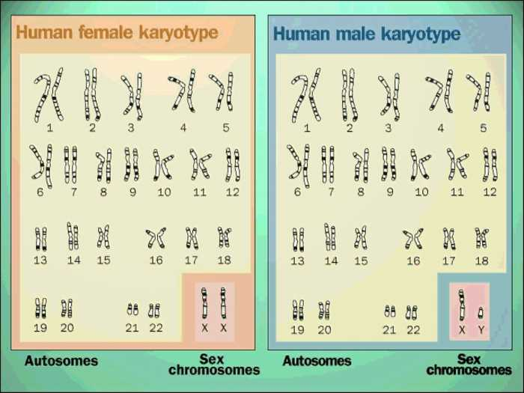
Warm-Up
Which karyotype is a male? How can you tell?
Which karyotype is a female? How can you tell?

Slide 13
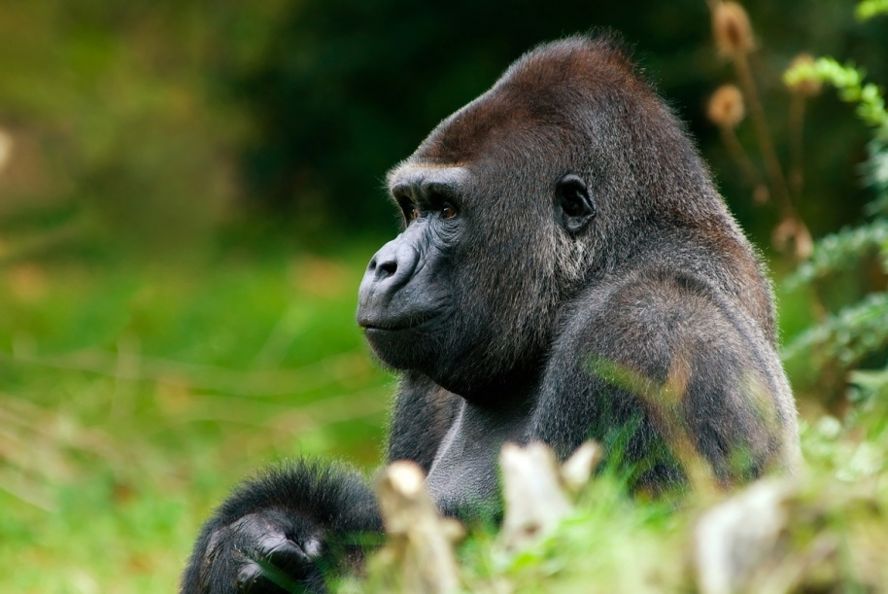
Friday, January 31, 2014
Fun Fact
Gorillas and potatoes have two more chromosomes than humans do.
Today’s Agenda
Warm-Up
Go over Critical Reading HW Assignment
Cell Cycle Intro.
Today’s Needs: Binder, Highlighter, Pencil

Slide 14
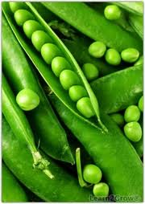
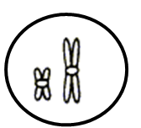
Warm-Up
What is the difference between diploid and haploid?
If a garden pea has 20 total chromosomes. What is the number of haploid?
3) True or False: The following figure displays homologous chromosomes.

Slide 15
 | Diploid | Haploid
About | Diploid cells contain two complete sets (2n) of chromosomes. | Haploid cells have half the number of chromosomes (n) as diploid - i.e. a haploid cell contains only one complete set of chromosomes.
Cell Division and Growth | Diploid cells reproduce by mitosis making daughter cells that are exact replicas. | Haploid cells are a result of the process of meiosis, a type of cell division in which diploid cells divide to give rise to haploid germ cells. A haploid cell will merge with another haploid cell at fertilization.
Examples | Skin, blood, muscle cells (also known as somatic cells) | Cells used in sexual reproduction, sperm and ova (also known as Gametes).

Slide 16
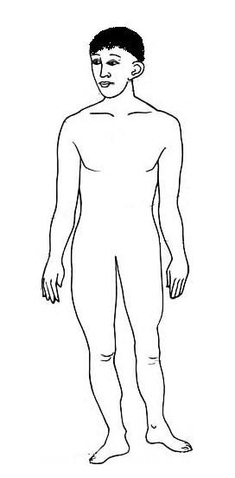
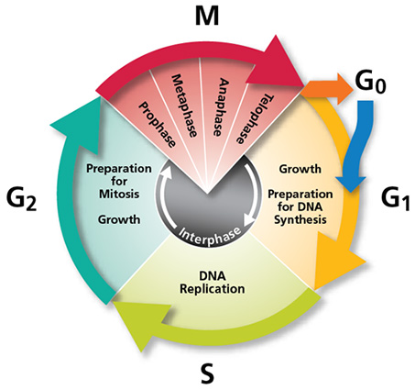
Why is the cell cycle important?

Slide 17
NEW WEEK SLIDES
February 3 – February 7

Slide 18

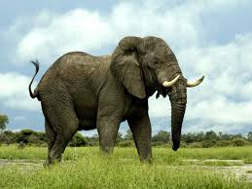
Monday, February 3, 2014
Fun Fact
A medium-sized cumulus cloud weighs about the same as 80 elephants.
Today’s Agenda
Warm-Up
Cell Cycle Overview
Video
Today’s Needs: Binder, Highlighter, Pencil

Slide 19
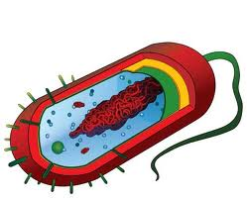
Warm-Up
What type of cell division do prokaryotes undergo?
What are the steps of this process?

Slide 20
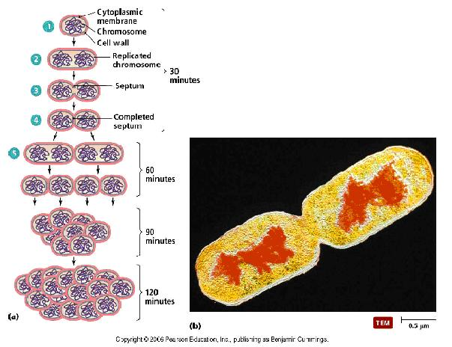
Binary Fission
STEPS
DNA is copied
Cell begins to divide
Two identical haploid cells are created

Slide 21
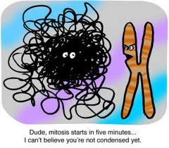
Thursday, February 6, 2014
Today’s Agenda
Pick up handouts from back of classrooms
Warm-Up
Review Mitosis
Quiz
Today’s Needs: Binder/Folder & Pencil/Pen

Slide 22
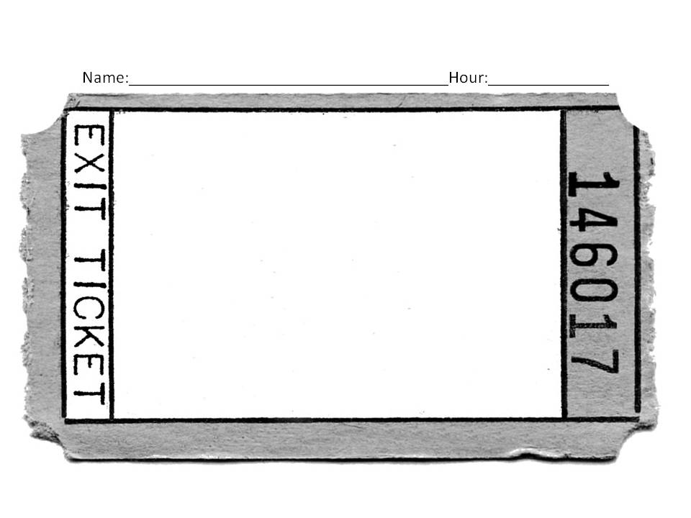
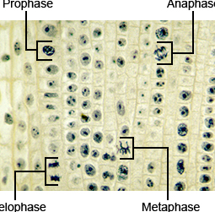
Match the following cells undergoing mitosis (A-D) with the correct phase name.
A
B
___ Prophase
___Metaphase
___ Anaphase
___ Telophase
C
D
Warm-up Questions (front)

Slide 23
Warm-up Questions (back)
Match the description to the correct phase of mitosis:
prophase, metaphase, anaphase, telophase, cytokinesis.
____________ Chromosomes align at the center of the cell.
____________ The cell splits into two daughter cells.
____________ Sister chromatids start to pull apart.
____________ Chromatin (DNA & Proteins) condenses forming chromosomes and spindle fibers begin to form.
____________ Chromosomes reach opposite poles, the spindle fibers break down, and the nucleus reappears.

Slide 24
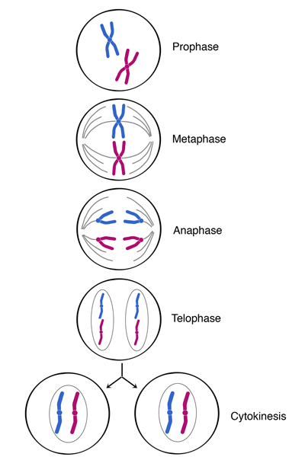
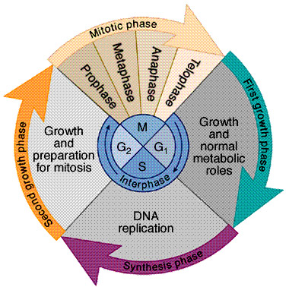
Quiz Review

Slide 25
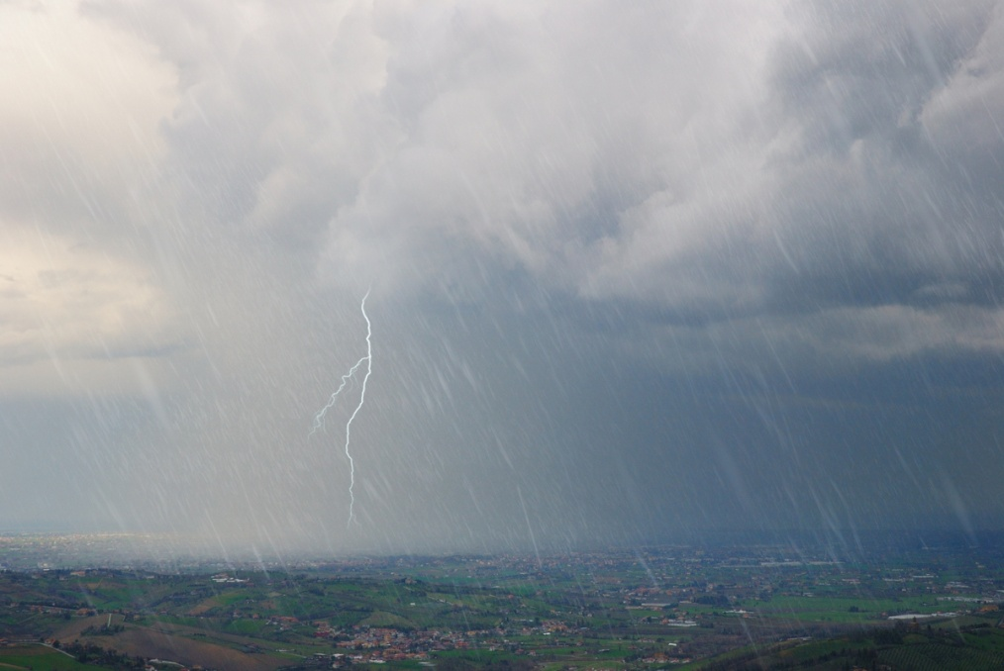
Friday, February 7, 2014
Fun Fact
A single bolt of lightning contains enough energy to cook 100,000 pieces of toast.
Today’s Agenda
YAY! It’s Friday!
Go over quiz
8.2 Questions
Meiosis Video w/KWL
Today’s Needs: Binder/Folder & Pencil/Pen

Slide 26
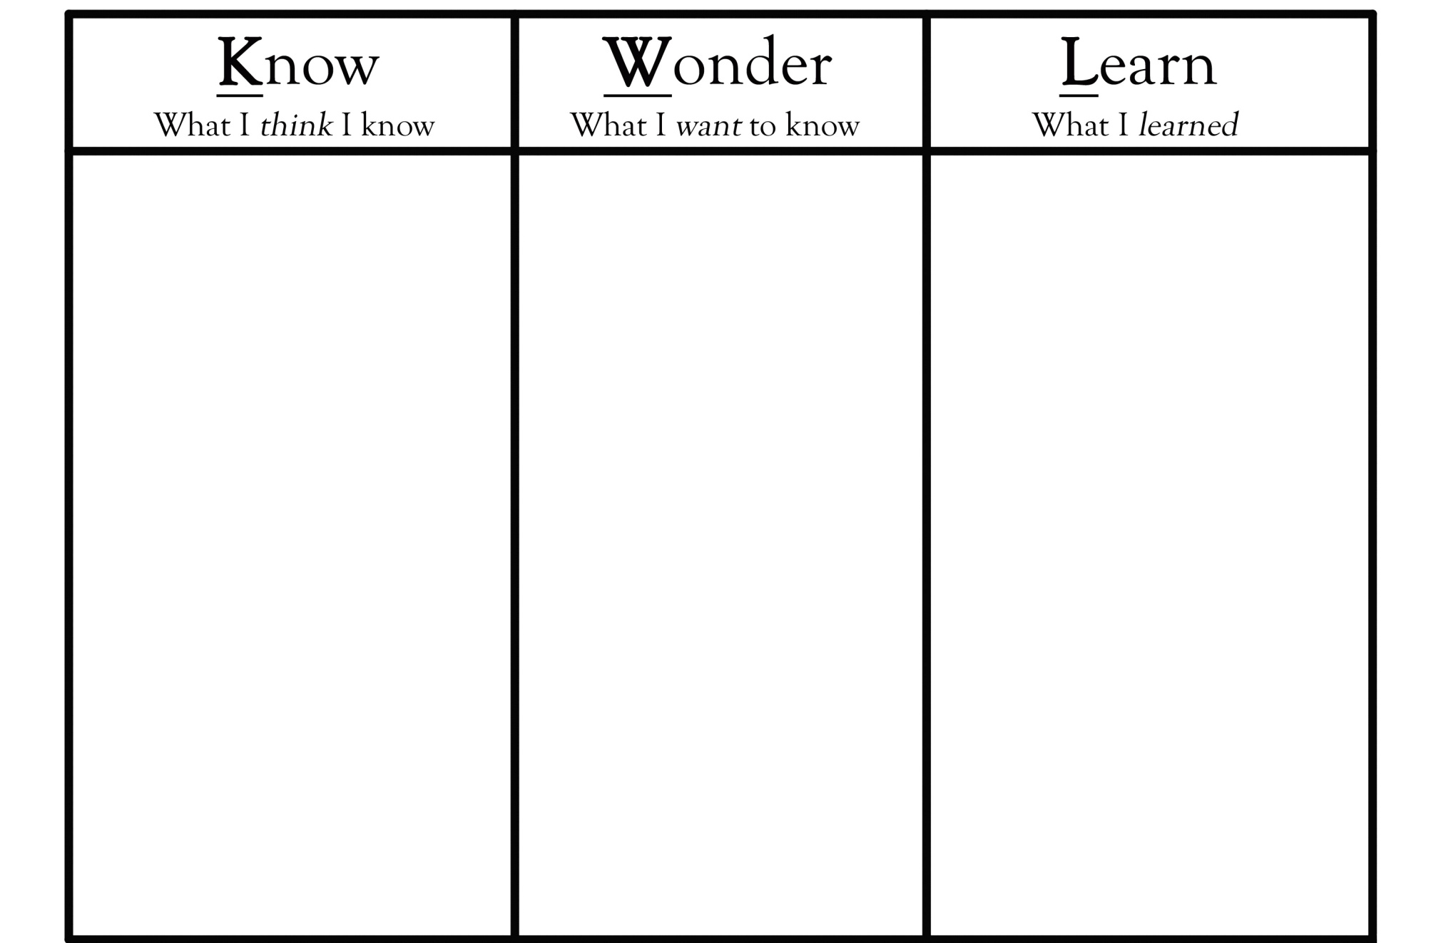
Name: _________________________Topic: ______________Hour:____

Slide 27
NEW WEEK SLIDES
February 10 – February 14

Slide 28
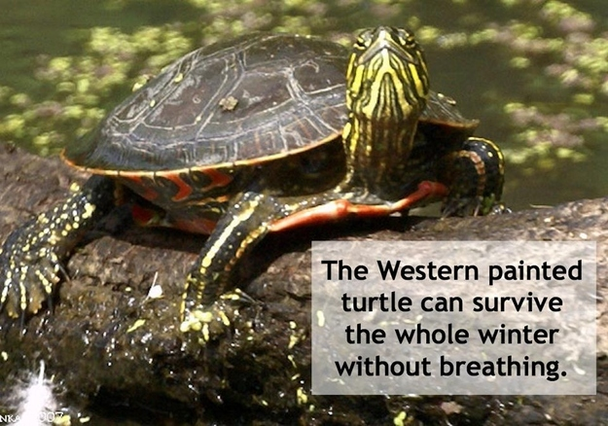
Monday, February 10, 2014
Today’s Agenda
Warm-Up
Process of Meiosis
Fun Fact
Today’s Needs: Binder/Folder & Pencil/Pen

Slide 29
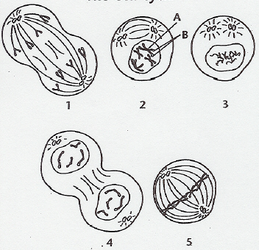
Warm-Up
Using the diagram below, determine the correct order of the phases of the cell cycle

Slide 30
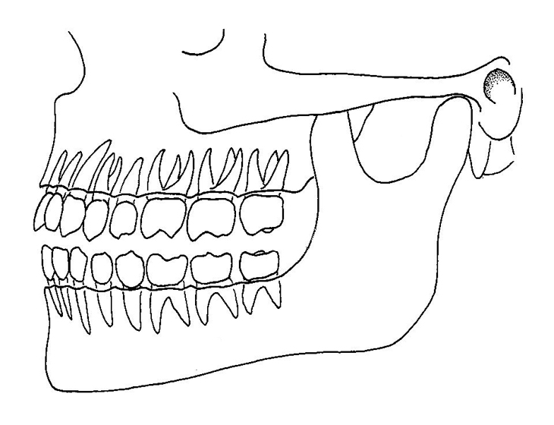
Wednesday, February 12, 2014
Fun Fact
The tooth is the only part of the human body that cannot repair itself.
Today’s Agenda
Warm-Up
Quiz
Vocabulary Words
8.3 Questions
Today’s Needs: Binder/Folder & Pencil/Pen

Slide 31
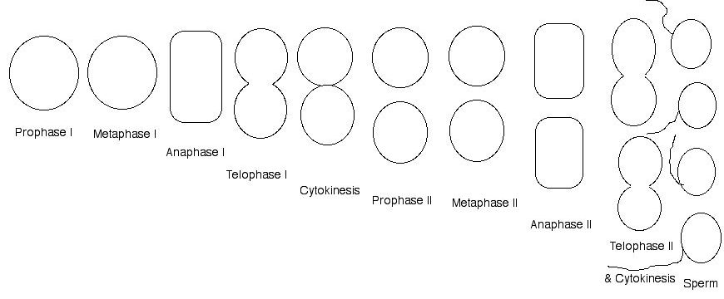
Warm-Up
In the spaces below, draw the phases of meiosis starting at Prophase 1. Remember, the cell has already grown and the DNA has been copied. Therefore, the two chromosomes pictured below in prophase 1 are homologous chromosomes. In the empty cells below, illustrate the movement of the chromosomes through meiosis.

Slide 32
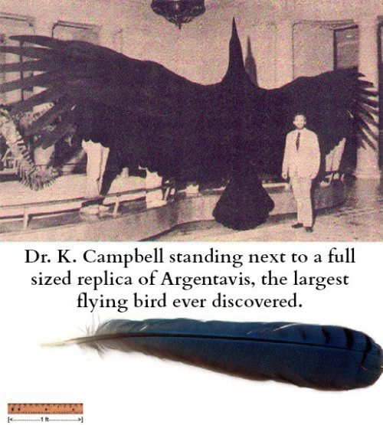
Thursday, February 13, 2014
Today’s Agenda
Pick up handout in back of classroom
Turn in HW into green box at front of class
Go over quiz
Reproduction Flow Chart
Jeopardy Review
Fun Fact
Today’s Needs: Binder/Folder & Pencil/Pen

Slide 33
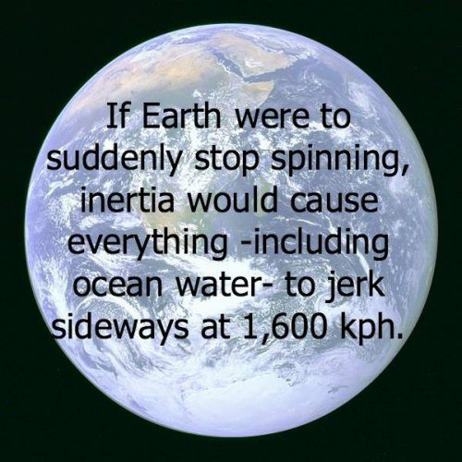
Friday, February 14, 2014
Fun Fact
Today’s Agenda
Any Questions?
Ch8 TEST
After the test
  Silent Reading
  Puzzles
Today’s Needs: Pencil/Pen

Slide 34
NEW WEEK SLIDES
February 17 – February 21

Slide 35
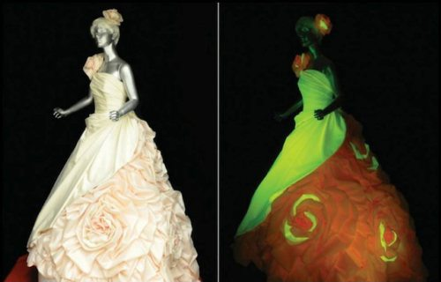
Thursday, February 20, 2014
Fun Fact
In Japan, some wedding dresses are made out of the silk of silkworms. The silk glows green, red, or orange under UV light.
Today’s Agenda
Genetics Pre-test
Critical Reading Article Assignment
Today’s Needs: Pencil/Pen

Slide 36
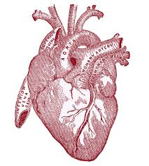
Friday, February 21, 2014
Today’s Agenda
HAPPY FRIDAY!
Organize Binder
Make-Up Work Day ☺
  Assignments/Quizzes/Tests
Fun Fact
Your heart beats around 100,000 times a day, 36,500,000 times a year and over a billion times if you live beyond age 30
Today’s Needs: Binder/Folder & Pencil/Pen

Slide 37
NEW WEEK SLIDES
February 24 – February 28

Slide 38

Monday, February 24, 2014
Today’s Agenda
Warm-Up
New Unit: What is genetics?
Gregor Mendel PowerPoint w/Notes
Summary Video w/ Exit Ticket
Fun Fact
If you yelled for 8 years, 7 months, and 6 days, you would have produced enough sound energy to heat up one cup of coffee.
Today’s Needs: Binder, Lined paper for notes,
Pencil and Warmup sheet

Slide 39
Warm-Up
On your warm-up sheet, please answer the following question using 2-3 sentences.
What is genetics?
How does genetics relate to you?

Slide 40
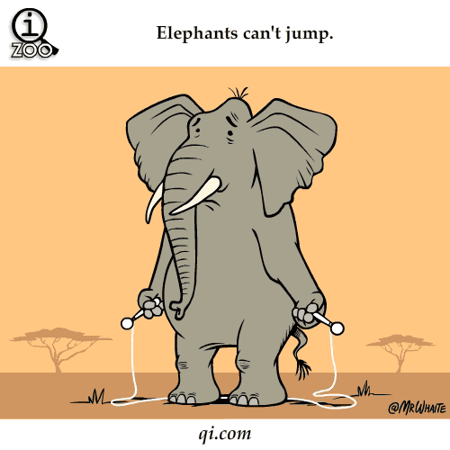
Wednesday, February 26, 2014
Fun Fact
Elephants are the only animals that can’t jump.
Today’s Agenda
Warm-Up
Video Clip
PTC Genetic Trait
CER Conclusions
Today’s Needs: Binder/Folder & Pencil/Pen

Slide 41
Warm-Up
Give an example of two people who are related to each other and explain the characteristics they have in common with each other.

Slide 42

Today’s Objectives
I CAN...
  Use evidence collected as a class to develop a conclusion about the ability to taste PTC.

Slide 43
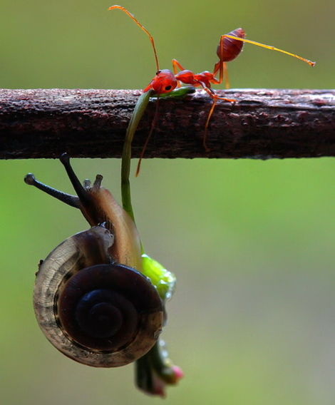
Thursday, February 27, 2014
Fun Fact
The ant can lift 50 times its own weight, can pull 30 times its own weight.
Today’s Agenda
Warm-Up
Its all about Traits – PowerPoint
Quiz ☺
Today’s Needs: Binder, Vocab. Sheet from back of classroom & Pencil/Pen

Slide 44
Warm-Up
Write about your experiences with the PTC test we did yesterday.
State if you were a taster or a non-taster.
Discuss what your thoughts of the activity.
What did you learn?

Slide 45
Today’s Objectives
I CAN...
  Identify inherited and acquired traits.
  Determine if a trait is dominant or recessive.

Slide 46
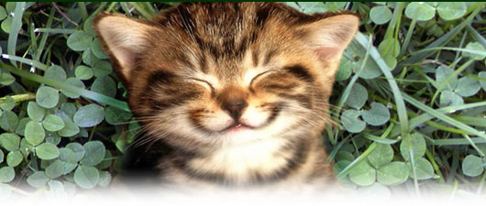
Friday, February 28, 2014
Today’s Agenda
Warm-Up
Finish PowerPoint
More genetics vocabulary
Worksheet
Fun Fact
It takes 17 muscles to smile and 43 to frown.
Today’s Needs: Binder, Vocab. Sheet from back of classroom & Pencil/Pen

Slide 47
Warm-Up
Explain how a child could have blue eyes when both the mother and father have brown eyes.

Slide 48
Today’s Objectives
I CAN...
  Explain/Define the following vocabulary words
    Dominant
    Recessive
    Homozygous
    Heterozygous
    Phenotype & Genotype

Slide 49
NEW WEEK SLIDES
March 3 – March 7

Slide 50
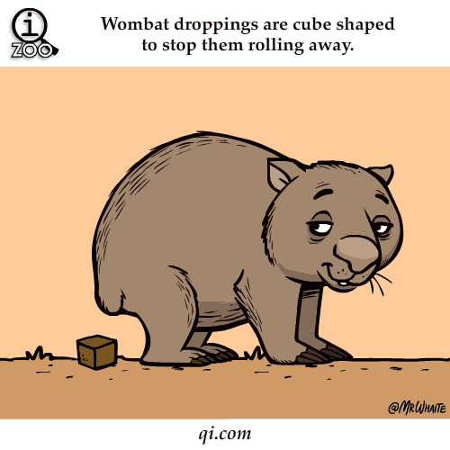
Thursday, March 6, 2014
Fun Fact
Wombat (type of animal) droppings are cube shaped to keep them from rolling away in order to mark their territory
Today’s Agenda
Warm-Up
Return Quizzes/ Questions?
Beyond Mendel
Worksheet
http://www.youtube.com/watch?v=m52Rdp_b5dQ
Today’s Needs: Binder/Folder & Pencil/Pen

Slide 51
Warm-Up
Cross a heterozygous male with a widows peak with a homozygous female with a straight hairline.
  Widows peak is the dominant trait
DRAW A PUNNETT SQUARE
What will be the genotypes of the offspring?
What is the genotypic ratio?
What will be the phenotypes of the offspring?
What is the phenotypic ratio?

Slide 52
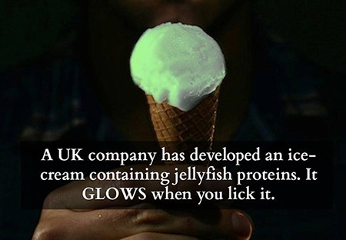
Friday, March 7, 2014
Today’s Agenda
Pick up paper in back of class
Turn in Homework
Genetics Wheel
4. Catch up day
Fun
Fact
Today’s Needs: Binder/Folder & Pencil/Pen

Slide 53
NEW WEEK SLIDES
March 10 – March 14

Slide 54
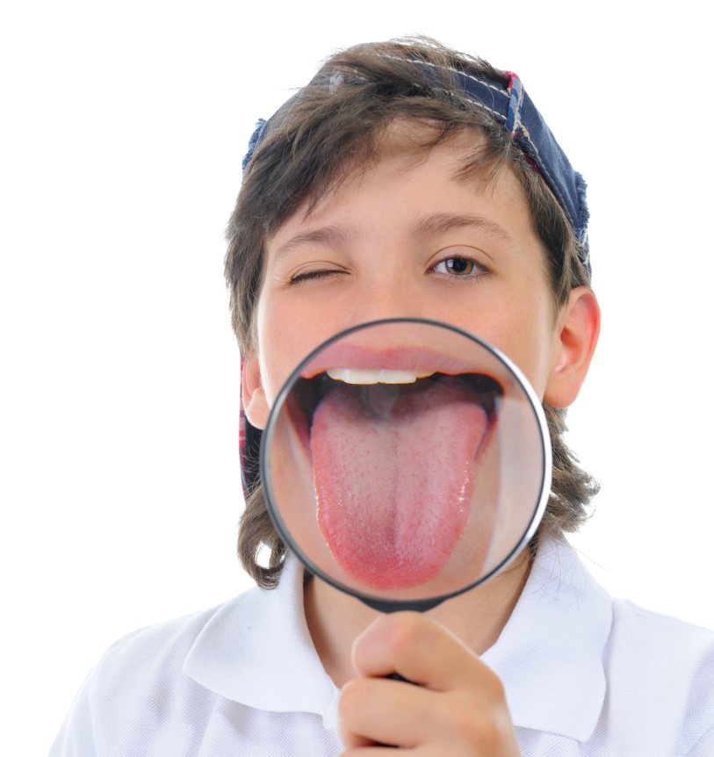
Monday, March 10, 2014
Fun Fact
The strongest muscle in the body is the tongue.
Today’s Agenda
Pick up worksheets from back
Warm-Up
More on Inheritance
Bloodtype worksheet
Today’s Needs: Binder/Folder & Pencil/Pen
Today’s Needs: Binder/Folder & Pencil/Pen

Slide 55
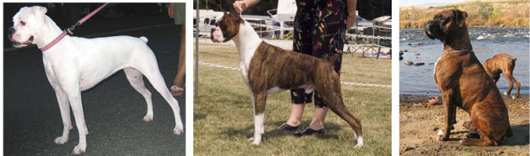
Warm-Up
Explain in 3-5 sentences, why/how you think if a white dog crossed with a brown dog would produce offspring that are white and brown.

Slide 56
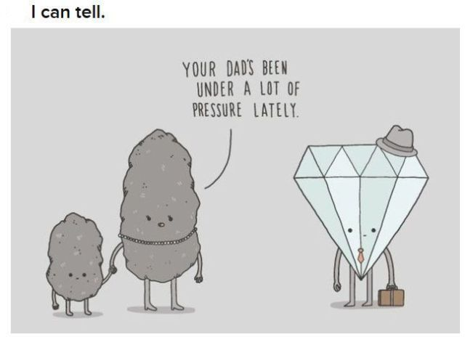
Tuesday, March 11, 2014
Today’s Agenda
Pick up worksheets from back
Review Codominance
Sex-Linked Traits
Fun Fact
Today’s Needs: Binder/Folder & Pencil/Pen

Slide 57
Warm Up
In a certain case a woman’s blood type was tested to be AB. She married and her husbands blood type was type A. Their children have blood types A, AB, and B.
What are the genotypes of the parents?
Is it possible that the man and the women could have children with these blood types?

Slide 58
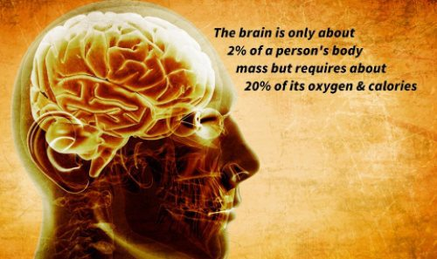
Wednesday, March 12, 2014
Today’s Agenda
Warm-Up
Review
Make Up Day ☺
Critical Reading
220-223, 227-232
Fun Fact
Today’s Needs: Binder/Folder & Pencil/Pen

Slide 59
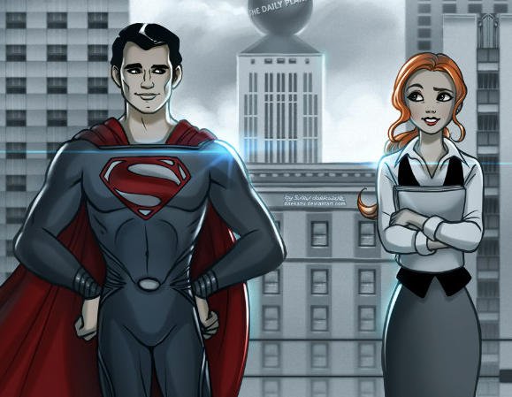
Warm-Up
Superman and Lois recently were married and are now expecting a baby.
Super human strength is a sex-linked trait carried on the X chromosome. Lois does not have the super human strength trait, but is a carrier for super human strength. (Draw a punnett square)
  What are the chances of a girl with super human strength?
  What are the chances of a boy with super human strength?

Slide 60
Homework: ALL DUE FRIDAY!!!
Reading Questions #1-6 page 169
Reading Questions #1-4 page 178
Codominance & Incomplete Dominance Worksheets (Dr. Seuss)
Blood Type Codominance Worksheet
Sex-linked Worksheet
Sex-Linked WS Fred & Wilma Flinstone

Slide 61
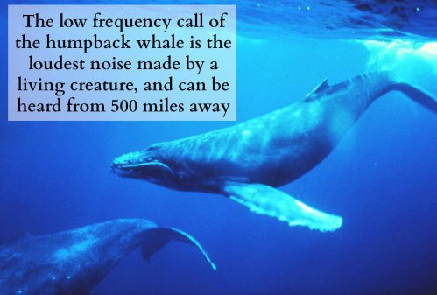
Thursday, March 13, 2014
Today’s Agenda
Pick up worksheets
Pedigrees PowerPoint!
Practice with Pedigrees
Fun Fact
Today’s Needs: Binder/Folder & Pencil/Pen

Slide 62
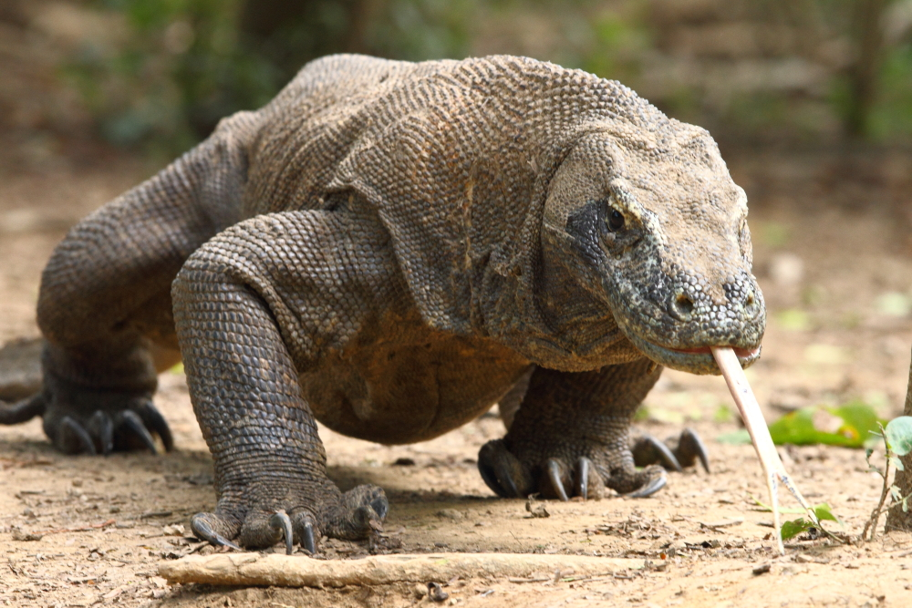
Friday, March 14, 2014
Fun Fact
Today’s Agenda
It’s Friday!
Quiz
Dragon Genetics Project!
Komodo dragons are the biggest and heaviest lizards on Earth.
Full-grown adults can reach 10 ft long and weigh more than 300 pounds.
Today’s Needs: Binder/Folder & Pencil/Pen

Slide 63
NEW WEEK SLIDES
March 17 – March 21

Slide 64
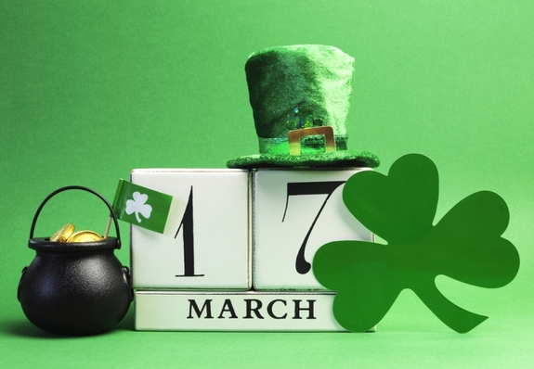
Monday, March 17, 2014
Today’s Agenda
DRAGON GENETICS PROJECT!
Fun Fact
The actual color of St. Patrick is blue.
Green became associated with St. Patrick's Day during the 19th century. Green, in Irish legends, was worn by fairies and immortals, and also by people to encourage their crops to grow.
Today’s Needs: Binder/Folder & Pencil/Pen

Slide 65
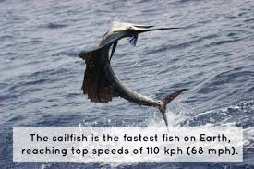
Tuesday, March 18, 2014
Fun Fact
Today’s Agenda
DRAGON GENETICS PROJECT!
Today’s Needs: Binder/Folder & Pencil/Pen

Slide 66
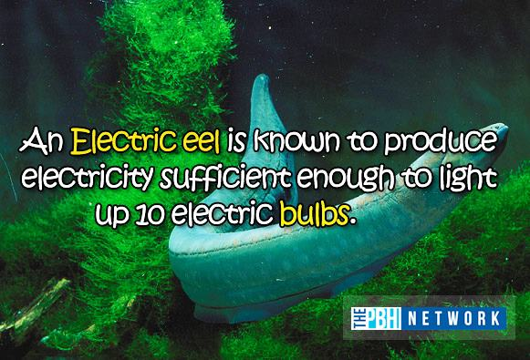
Wednesday, March 19, 2014
Today’s Agenda
Genetics Unit Test
Grade Reports
Missing Work /Extra Credit
Turn in Projects
Fun Fact
Today’s Needs: Pencil/Pen

Slide 67
Thursday, March 21, 2014
Fun Fact
Today’s Agenda
Genetics Unit Test
Grade Reports
Missing Work/Extra Credit
Turn in Dragon Genetic Projects
Today’s Needs: Pencil/Pen

Slide 68
NEW WEEK SLIDES
March 24 – March 28

Slide 69
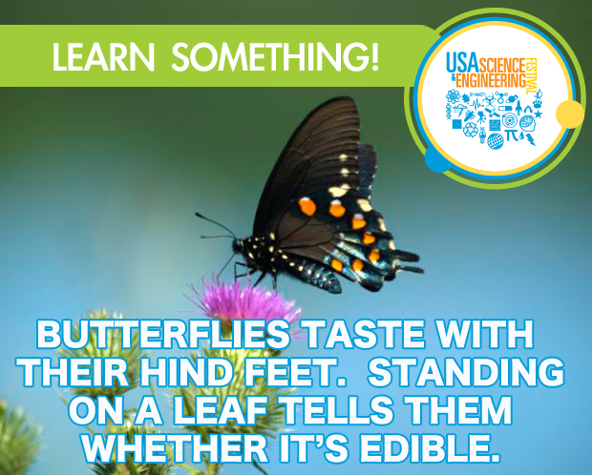
Monday, March 24, 2014
Today’s Agenda
Pick up worksheets from back.
Review Expectations
Warm-Up
New Unit: DNA
The Secret of Life PowerPoint
Fun Fact
Today’s Needs: Binder/Folder & Pencil/Pen

Slide 70
Classroom Expectations
If you miss class time:
  Ask for assignments/Notes
  Either come after school or catch up on itslearning.com
3…2..1.0 – Silence @ 0
During Lecture:
  Silence
  Focus
  Taking Notes if necessary or filling out worksheets
  Raising hand when a question arises

Slide 71
Warm Up
On your warmup sheet please answer these three questions to the best of your ability.
    What is DNA?
    What does it do?
    What’s DNA made of?

Slide 72

Tuesday, March 25, 2014
Fun Fact
Today’s Agenda
Pick up worksheet
Turn in HW
Concept Map
DNA Extraction Lab
Today’s Needs: Pencil/Pen

Slide 73
Today’s Objectives
I CAN...
  Describe the appearance of DNA
  Explain the method of DNA extraction

Slide 74

Thursday, March 27, 2014
Today’s Agenda
Pick up worksheet from back
Warm-Up/Reminder
Review DNA Replication & Structure
Quiz!
Review DNA Extraction Lab
Fun Fact
Today’s Needs: Binder/Folder & Pencil/Pen

Slide 75
Warm Up
During DNA replication what is the first process to occur?
Name the enzymes involved in DNA replication.
WHAT is the end result of DNA replication ?

Slide 76

Friday, March 28, 2014
Fun Fact
A moose can feel a fly landing on its antlers.
Today’s Agenda
Pick up worksheets
Warm-Up Class Activity
Quizzes
RNA
DNA Transcription
Weekend HW
Today’s Needs: Binder/Folder & Pencil/Pen

Slide 77
NEW WEEK SLIDES
March 31 – April 3

Slide 78

Monday, March 31, 2014
Today’s Agenda
Warm-Up QUIZ
Review Transcription
Review Types of RNA
DNA Translation (Making Proteins)
Homework
Fun Fact
During your lifetime, you will produce enough saliva to fill two swimming pools.
Today’s Needs: Binder/Folder & Pencil/Pen

Slide 79
Compare & Contrast DNA & RNA using a Venn Diagram.
What are the similarities & differences?

Slide 82

Tuesday, April 1, 2014
Today’s Agenda
Pick up worksheets from back
Finish Translation
Practice Translation WS
Today’s Needs: Binder/Folder & Pencil/Pen

Slide 83
Important Dates
ALL assignments are due Wednesday, April 2!
  That is tomorrow!
After School Hours
  Ms. Robinson 2:30 – 3:30 Tuesday
  Ms. Robinson 2:30 – 4:00 Wednesday
  (Study Session for Test)
Unit Test on Thursday, April 3

Slide 84
Warm Up
Describe the steps occuring in translation?
Where in the cell does translation occur?
What is the product of translation?

Slide 85

Wednesday, April 3, 2014
Today’s Agenda
Warm-up
Review Processes
HW Questions
REVIEW DAY!
Fun Fact
Today’s Needs: Binder/Folder & Pencil/Pen

Slide 86

The diagram below is illustrating TRANSLATION.
What is the structure labeled A?
What is the structure labeled B?
What is the structure labeled C?
What is the structure labeled D?
What is the structure labeled E?

Slide 87
Review the processes associated with DNA
Process | Replication | Transcription | Translation
What Happens? STEPS
Key Players? Molecules? Enzymes? Etc.
Drawing

Slide 88

Thursday, April 3, 2014
Fun Fact
Today’s Agenda
Any Questions?
Unit Test
Silent Reading
HAPPY SPRING
BREAK
Today’s Needs: Pencil/Pen

Slide 89
EXTRA CREDIT
Create a DNA strand with 12 bases.
_______________________________________________
Use the DNA strand you created and make a copy
________________________________________________
Now use the copy you made to make a mRNA strand
________________________________________________
Now use the mRNA strand to create Amino Acids
_______________________________________________

