Slide 1
The Secret of Life
Ms. Robinson - STEM Biology
Innovation Central High School

Slide 2
Warm Up
What is DNA?
What does it do?
What’s DNA made of?

Slide 3
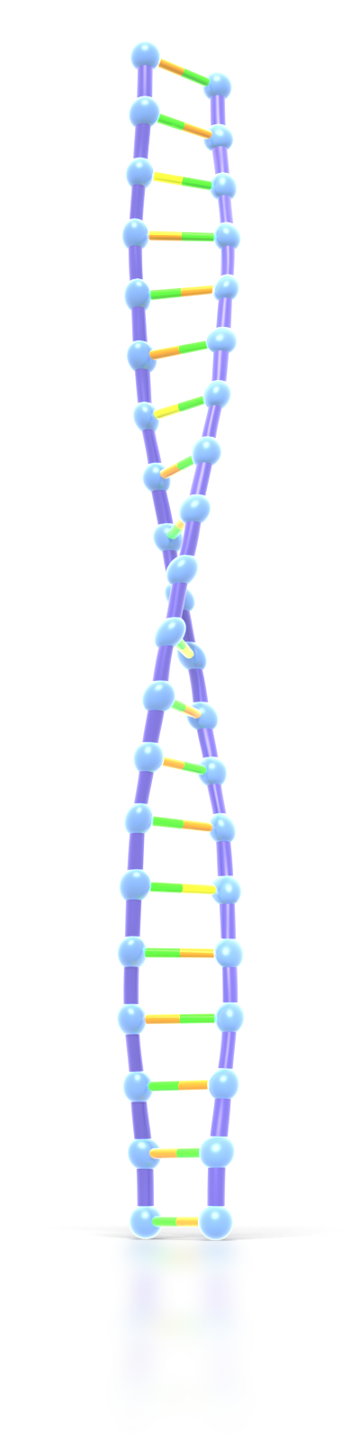
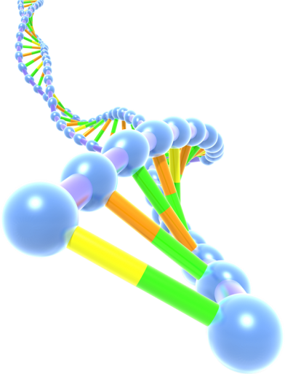
The Driving Force of Life

Slide 4
Video Reflection
What is life?
What is the driving force of life that connects us all?
What are the requirements for all living things?

Slide 5
DNA & LIFE
Requirements of Life
  Reproduction
  Growth
  Metabolism (Chemical Processes)
  Response/Reaction to Environment
*DNA is needed by every living organism because it is the information that is needed to allow living organisms to grow, survive and reproduce.
*Living things are made up of cells, and with DNA these cells just can’t exist!

Slide 6
What’s DNA?
Many definitions
  Deoxyribonucleic acid
  A molecular blueprint for a living thing
  The carrier of genetic information

Slide 7
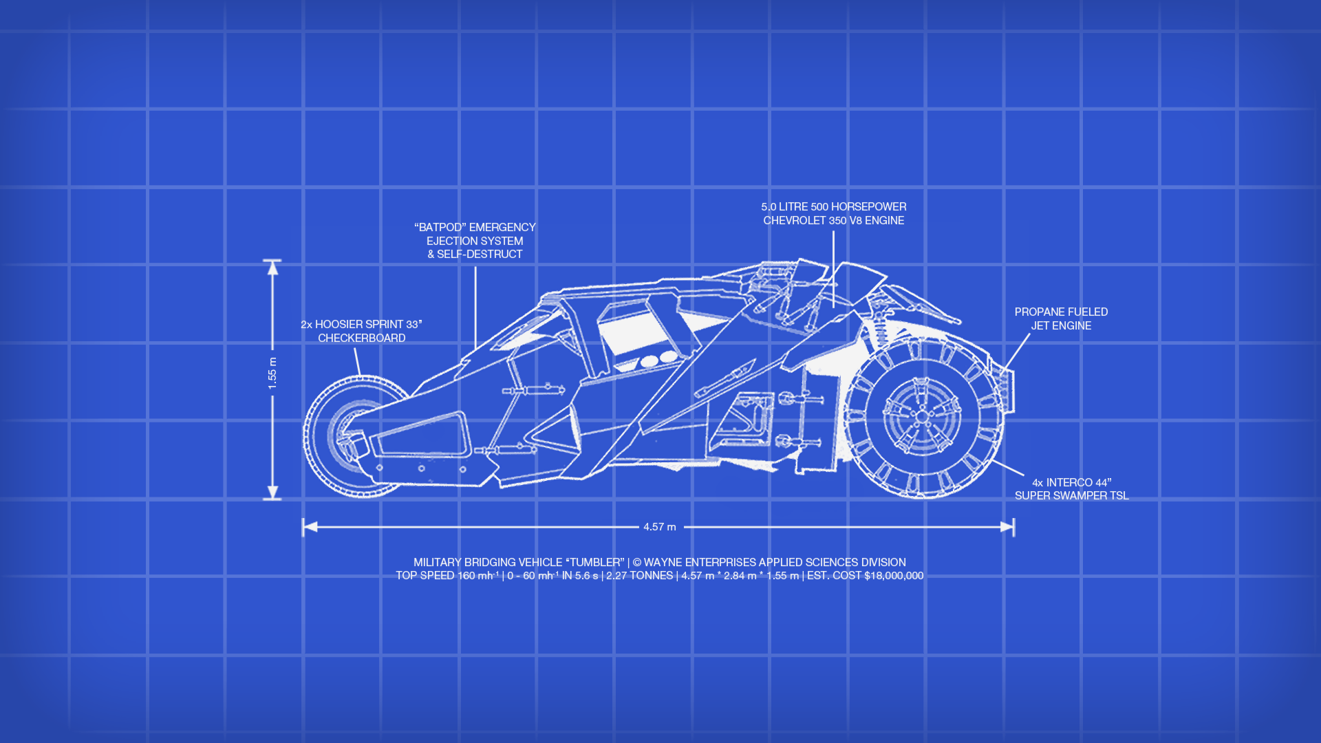
Notes:
http://fc04.deviantart.net/fs71/f/2012/209/1/d/batman_tumbler_blueprint_wallpaper_by_snowleppard-d58x0zv.png

Slide 8
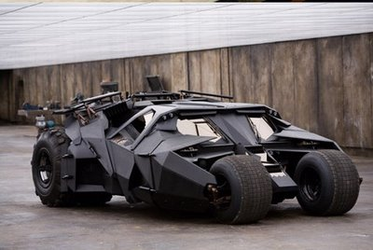
Notes:
http://blogs.riverfronttimes.com/dailyrft/batman_tumbler.jpg

Slide 9
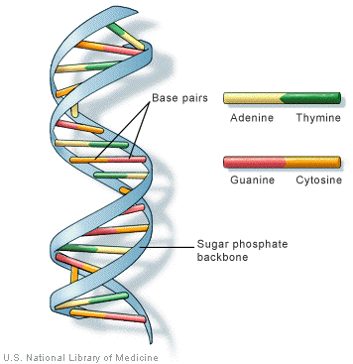
Notes:
http://www.chemguide.co.uk/organicprops/aminoacids/doublehelix.gif

Slide 10
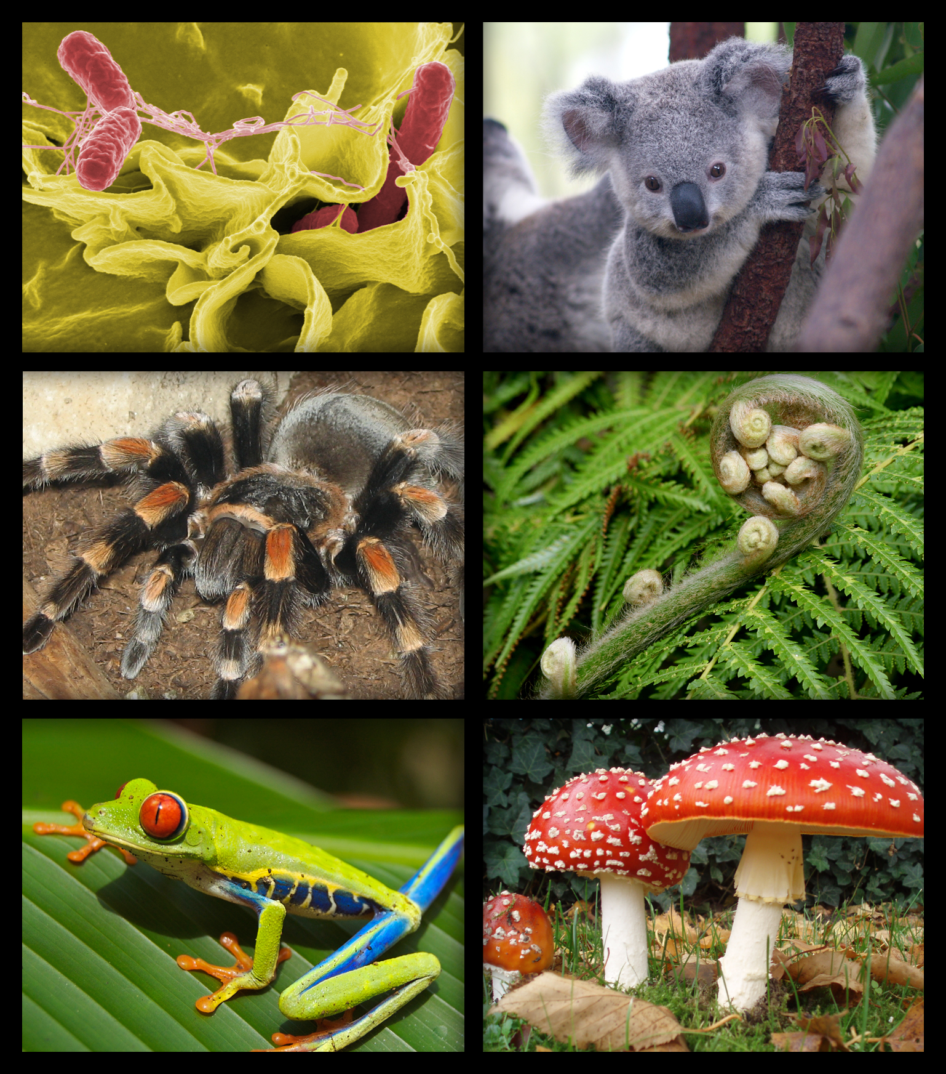
Notes:
http://upload.wikimedia.org/wikipedia/commons/7/7a/Biology_organism_collage.png

Slide 11
What does DNA do?
DNA is used to make RNA
Which is used to make Proteins
Which then make up an Organism.
Overall Function:
To store and transmit genetic information to make proteins that control the chemical processes in our bodies.

Slide 12
What’s DNA made of?
DNA is a chain of repeating nucleotides
A nucleotide can be broken down into 3 basic parts:
  Phosphate backbone
  5 Carbon Sugar (Pentose)
  Nitrogenous Base

Slide 13
What’s DNA made of?
Phosphate Backbone
Nitrogenous Base
5 Carbon Sugar

Slide 15
The Nitrogenous Bases
In DNA there are 4 Nitrogenous Bases
  The 2 ringed Purines
    Adenine
    Guanine
  The 1 ringed Pyrimidines
    Thymine
    Cytosine

Slide 16
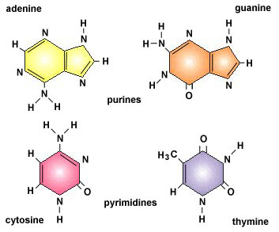
Notes:
http://faculty.ccbcmd.edu/biotutorials/dna/images/u4fg6b.jpg

Slide 17
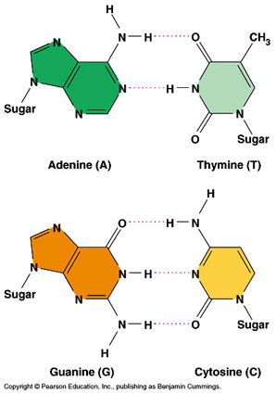
Base Pairing
These nitrogenous bases pair up specifically:
  Adenine with Thymine
  &
  Guanine with Cytosine
Notes:
http://www.bio.miami.edu/~cmallery/150/gene/c16x6base-pairs.jpg

Slide 18
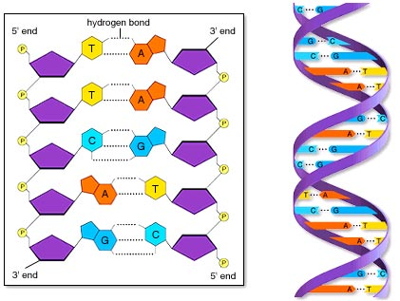
Base Pairing – Hydrogen Bonds
Notes:
http://www.mhhe.com/biosci/ap/ap_prep/cem1s9_3.jpg

Slide 19
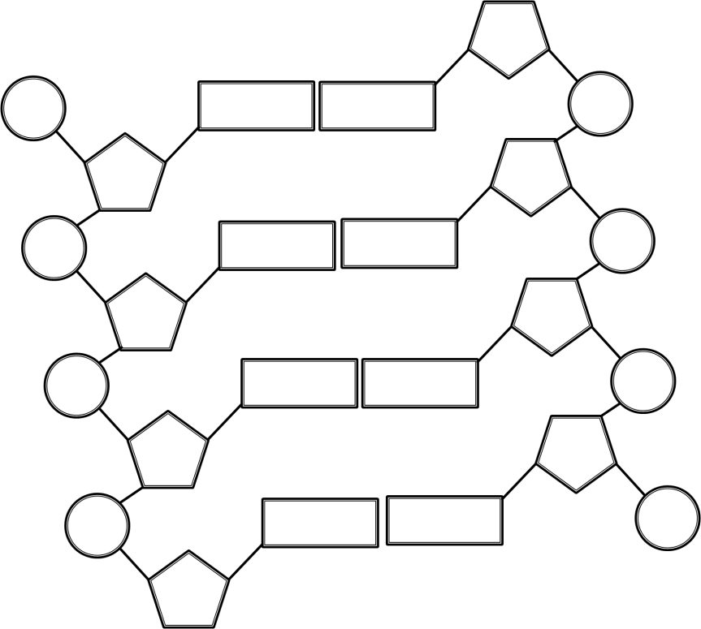
On your notes…
Label the Phosphates
  P
Label the Sugars
  S
Label the left bases
  A
  G
  C
  T
Write those base’s compliments on the right
Indicate where the H-bonds are (between the bases)

Slide 20
Historical Aspect of DNA
James Watson, Francis Crick, Rosalind Franklin and Maurice Wilkins

Slide 21
When was the structure of DNA solved?
1951… that’s only…
65 years ago. Not that long at all.
Science is always evolving!
New discoveries are made daily.

Slide 22
What else did we learn from the video?
DNA is what shape?
Why is that important?
What are the four known base pairs?
Which ones bond together?
How are the bases linked together?

Slide 23
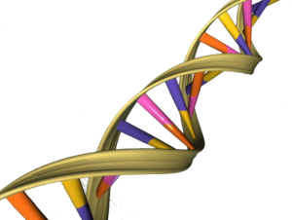

The shape of DNA
A double Felix…
No… wait…
That’s not right…
A double HELIX
Notes:
http://i397.photobucket.com/albums/pp52/ana_amelia/GatoFelix.png
http://thewellnessscientist.com/wp-content/uploads/2013/07/300x226xDNA_double_helix-300x226.png.pagespeed.ic.JZF5opSoPu.png

Slide 24
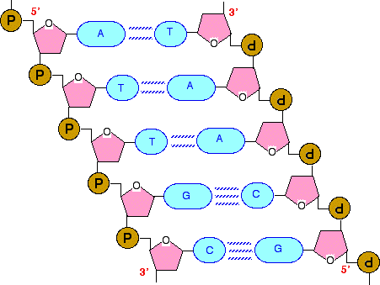
The Double Helix
Each individual strand of DNA is held together by strong covalent bonds
The two strands are held together by much weaker hydrogen bonds
Which form between the complimentary nitrogenous bases
Notes:
http://www.chemguide.co.uk/organicprops/aminoacids/dnachain2.gif

Slide 25
DNA Concept Map

Slide 26
Overview of DNA

Slide 27
References
DenHartigh, D. (2014). DNA UNIT 1 [PowerPoint].

