Slide 1
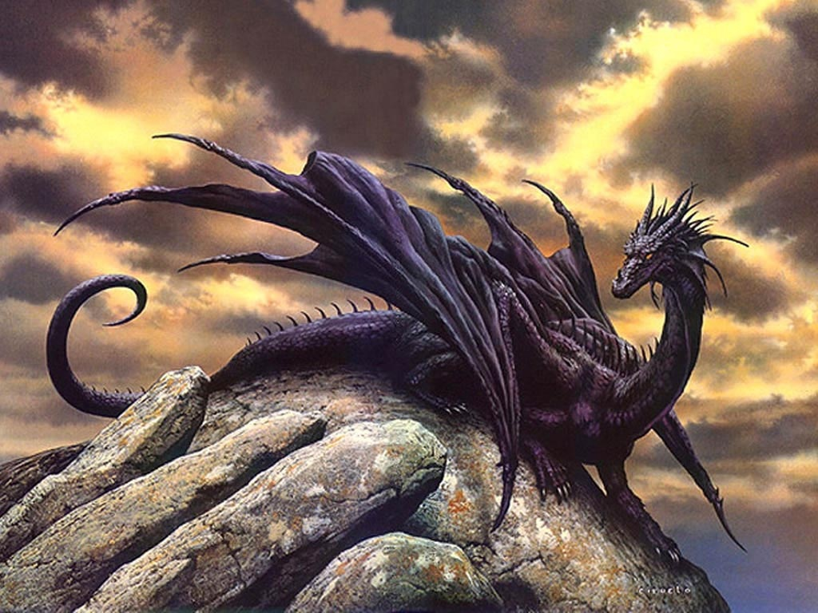

DRAGON GENETICS
PROJECT

Slide 2
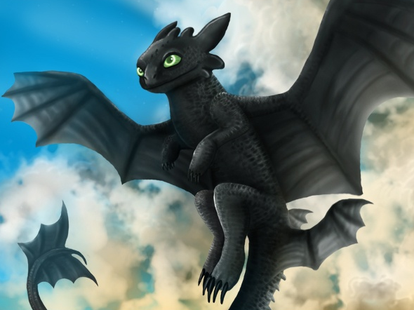
TASK/GOAL
Your task is to create a baby dragon.
You and your partner will be the parents of the baby dragon.
Using what you know and have learned about heredity in this unit, you will assemble a photo album booklet to present your baby dragon phenotype and genotypes.

Slide 3
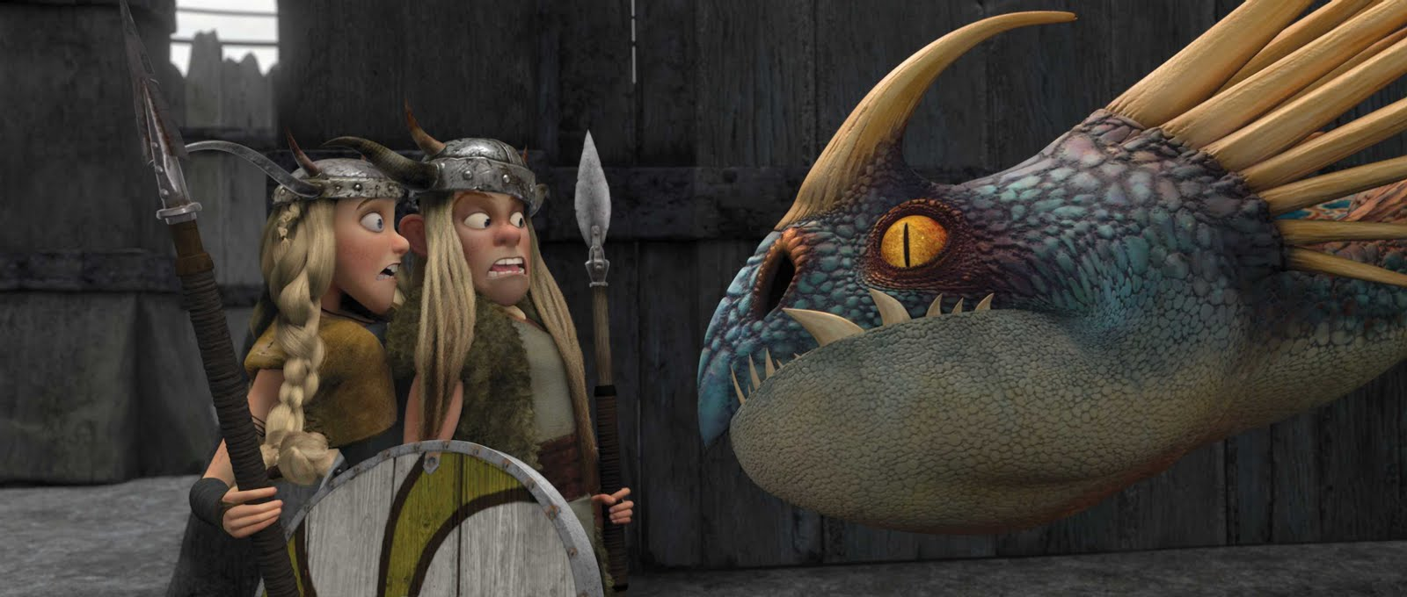
GRADES/RUBRIC
DUE: No later than Wednesday, March 19
Total 75 points!
  10 point are for your peer evaluation of your partner.
  YOU WILLL NEED TO WORK AS A TEAM, EVEN THOUGH IT MIGHT BE SCARY!

Slide 4
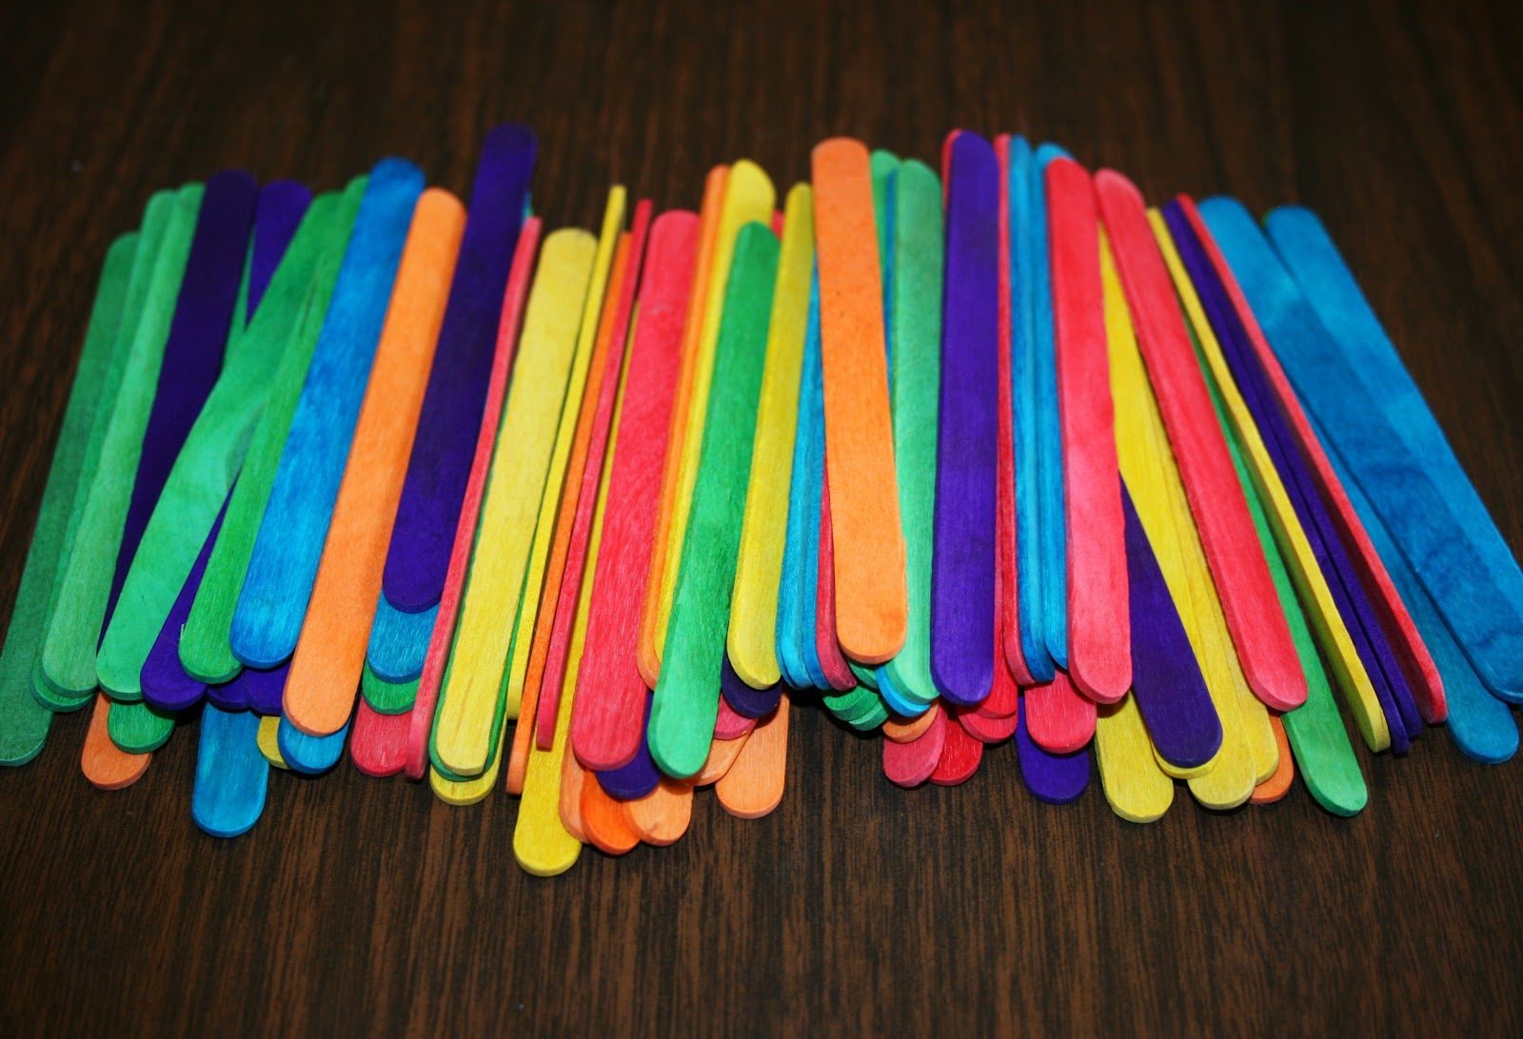
PROCEDURE: Materials
Each partner will get a bag containing 5 popsicles. (One female bag and one male bag per group)
These popsicle sticks (yellow, green, red, orange) represent autosomes, while the purple represents female sex chromosomes and the blue represents the male sex.
Each side of a stick represents a chromosome, and the two sides together represent a pair of homologous chromosomes.

Slide 5
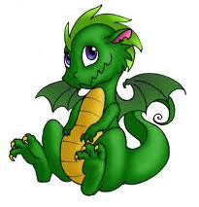
PROCEDURE
Creating a Baby Dragon
First, Record the Alleles for each parent on the tables provided. Be sure to write it in the correct form! Remember autosomes use capital and lower case letters. Sex chromosomes use X & Y and then either a capital or lower case as a exponent.
Determining the baby dragons traits
  For each color autosome and then for the sex chromosomes, each parent will randomly drop his or her stick on the table.
  The side of the stick that is up represents the chromosome that is passed on to the baby.
  Record the alleles from each pair of chromosomes in the data chart.

Slide 6
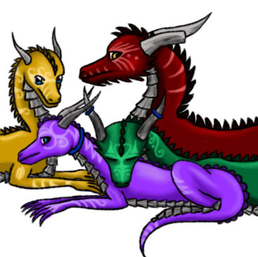
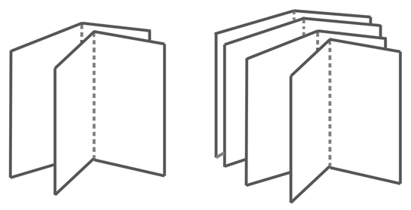
Assemble a Photo Album/Booklet
See rubric for details!

